Slide 1

Predicting Heart Disease Using Machine Learning: A Data-Driven Approach
A Project Presentation for the Data Science Faculty and Researchers.
Presented by: Ahmed Al-Mohammadi

Slide 2


Project Objective: Driving Precision in Early Detection
Our primary goal is to engineer a highly accurate and robust machine learning model capable of predicting the presence of heart disease in patients using clinical data.
Early detection is paramount to patient care. By achieving high predictive performance, our model can significantly inform diagnostic pathways and improve long-term patient outcomes.
Dataset Foundation: We utilized the renowned Cleveland Clinic Foundation Heart Disease Dataset, a reliable source for cardiovascular ML research.

Slide 3


From Raw Data to Refined Features: Preparation Pipeline
A successful machine learning model is built upon clean, well-processed data. Our pipeline focused on essential transformation steps to ensure model stability and optimal performance.
Handling Missing Values
Binary Target Conversion
Feature Scaling (Standardization)
Identified and addressed missing entries, specifically in the 'ca' (number of major vessels) and 'thal' (thalassemia) columns, using appropriate imputation techniques.
Transformed the original multi-class diagnosis (0-4 severity) into a clear binary 'target' variable: 0 for No Disease and 1 for Presence of Disease.
Applied StandardScaler to normalize numerical features. This is critical for distance-based algorithms to prevent features with larger magnitudes from dominating the loss function.

Slide 4
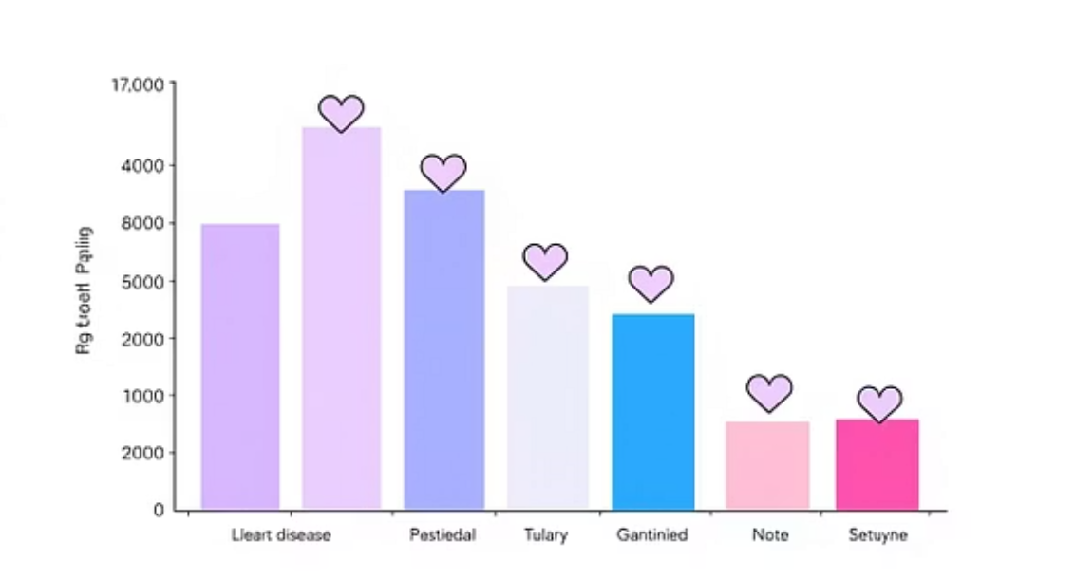
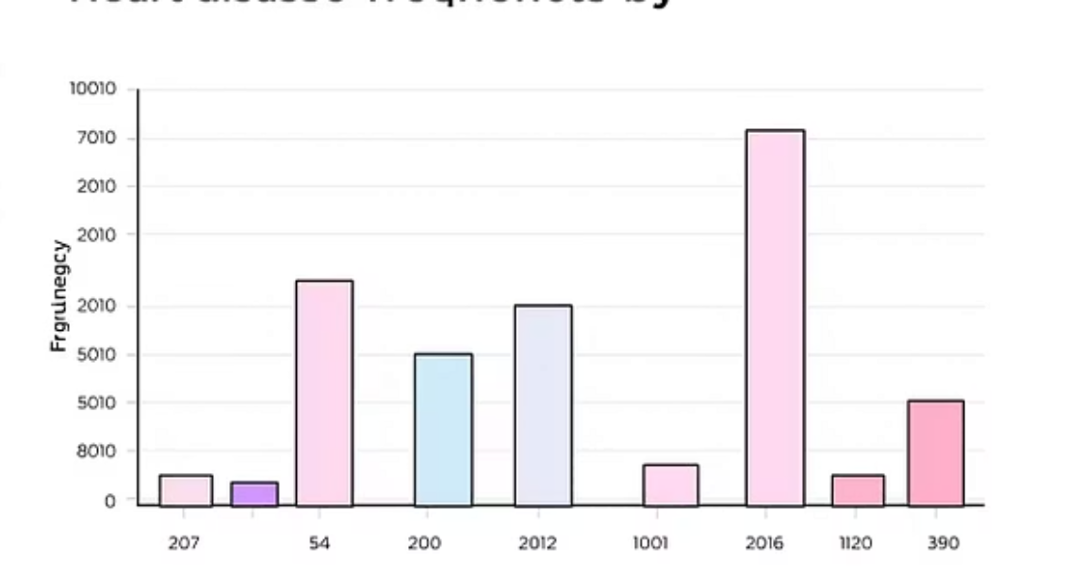
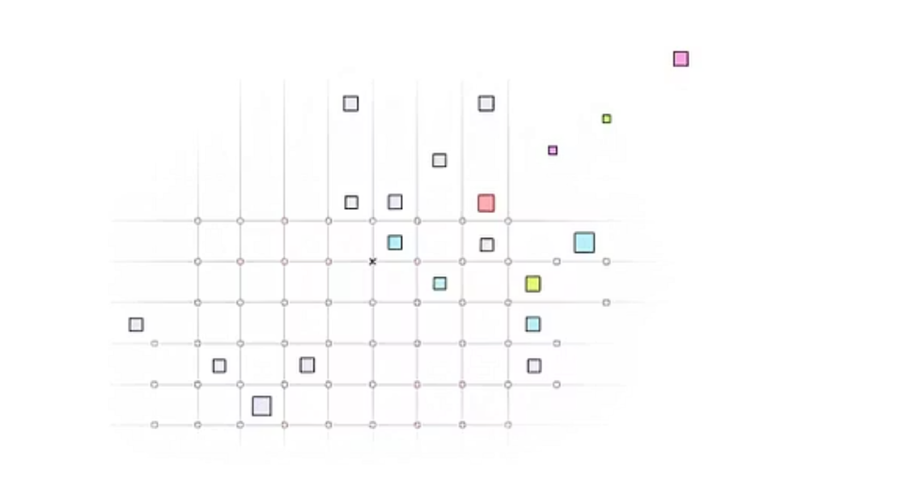
Exploratory Data Analysis (EDA): Uncovering Diagnostic Patterns
Visual exploration revealed inherent biases and strong predictive signals within the data, confirming the necessity of certain features for accurate prediction.
The analysis showed a clear correlation between specific chest pain types (Type 2 and 3) and disease presence, as well as a higher incidence rate in male patients within this specific dataset.

Slide 5
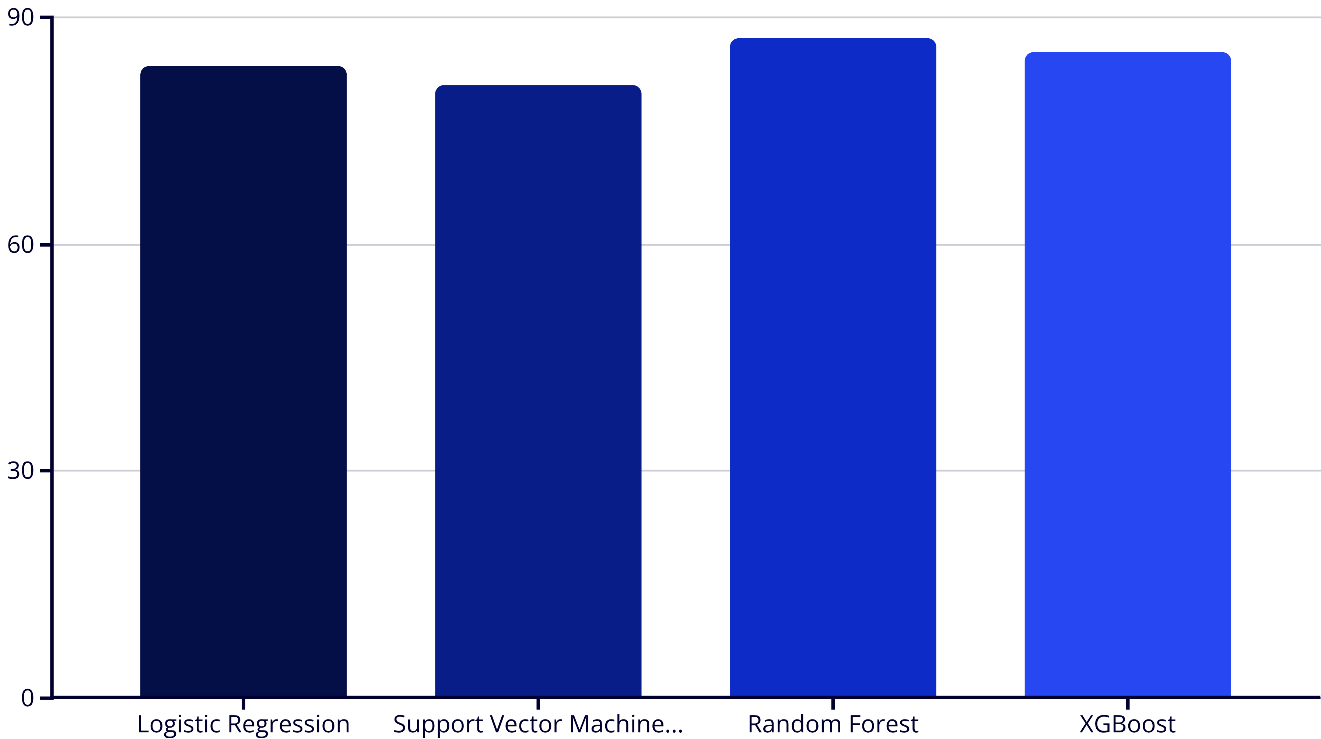
Model Selection: Establishing the Performance Baseline
We benchmarked four prominent machine learning classifiers to determine the most effective foundational algorithm for this prediction task.
The Random Forest Classifier achieved the highest initial accuracy, positioning it as our Champion Model for subsequent optimization.

Slide 6
Optimizing the Champion: Strategic Hyperparameter Tuning
To maximize the predictive power of the Random Forest model, we employed systematic hyperparameter tuning using GridSearchCV. This process explores a predefined grid of parameter combinations to find the configuration yielding the highest cross-validated performance.
1
2
3
Grid Search Implementation
Cross-Validation
Performance Lift
Defined parameter ranges for key hyperparameters like n_estimators, max_depth, and min_samples_split.
Used K-Fold cross-validation to prevent overfitting and ensure the selected parameters generalize well to unseen data.
Tuning resulted in a significant increase in overall accuracy, moving the model closer to deployment-ready performance.
87.2%
90.16%
Baseline Accuracy
Optimized Accuracy
Performance before hyperparameter tuning.
Final performance after tuning and optimization.

Slide 7
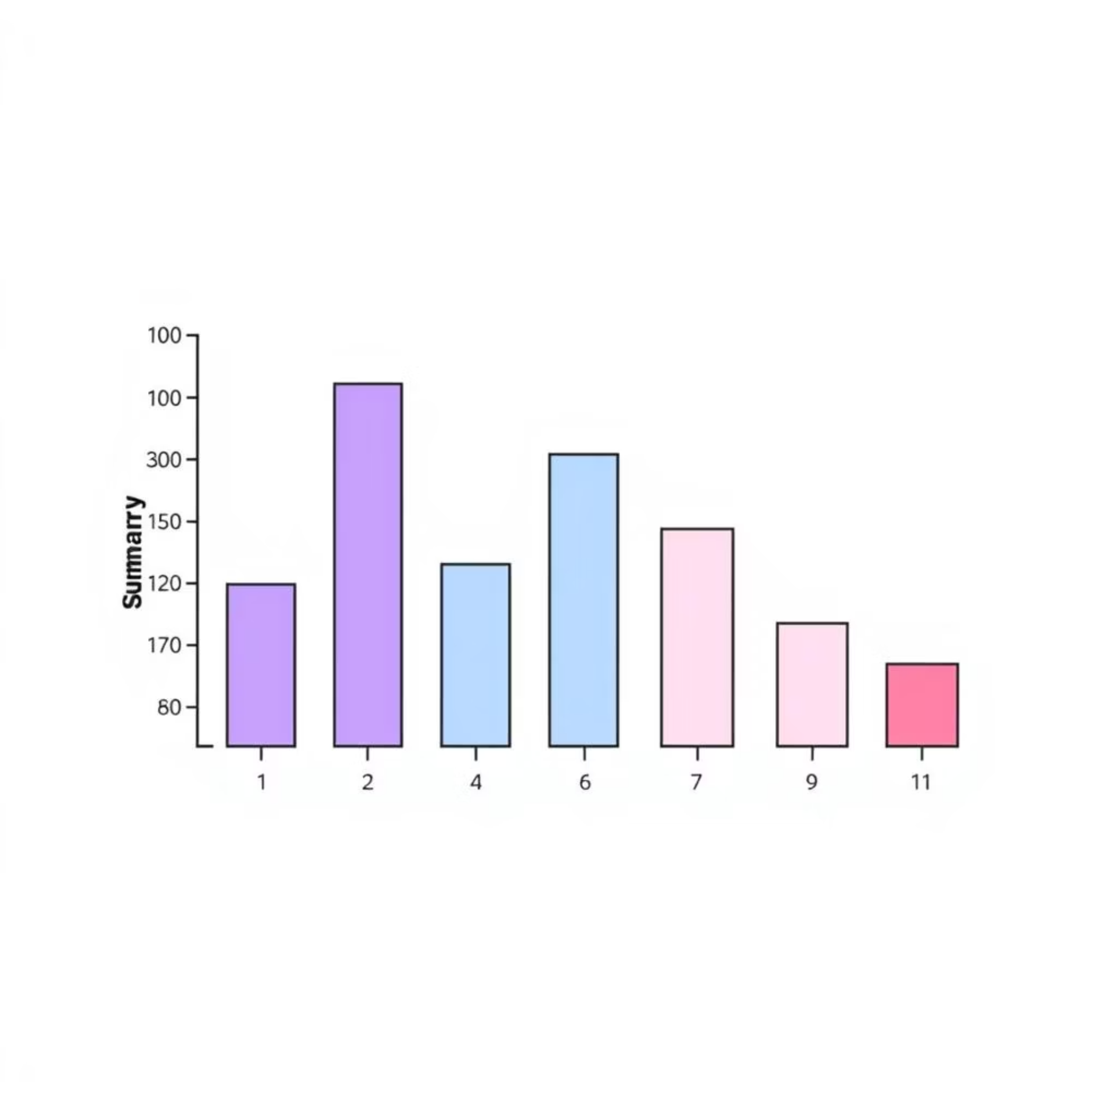
Interpreting the Black Box: Understanding Model Decisions with SHAP
In critical applications like medical diagnostics, knowing why a model makes a prediction is as important as the prediction itself. We leveraged SHAP (SHapley Additive exPlanations) to provide local and global interpretability.
Top Predictive Factors for Heart Disease
'ca': Number of major vessels colored by fluoroscopy
'thal': Thalassemia type (a blood disorder)
'cp': Chest pain type (Crucial indicator)
'oldpeak': ST depression induced by exercise relative to rest
The SHAP values quantify the contribution of each feature to the final prediction, ensuring transparency and clinical relevance.

Slide 8




Final Model Performance: Comprehensive Evaluation Metrics
To fully assess the model's clinical utility, we analyzed key classification metrics on the held-out test set.
90.16%
88%
Test Accuracy
Precision
Overall proportion of correct predictions.
Proportion of positive identifications that were actually correct (minimizing false positives).
92%
90%
Recall
F1-Score
Proportion of actual positives that were identified correctly (minimizing false negatives).
The harmonic mean of Precision and Recall, balancing both metrics.
The balanced performance across these metrics indicates the model is highly effective and reliable for predicting heart disease presence.

Slide 9
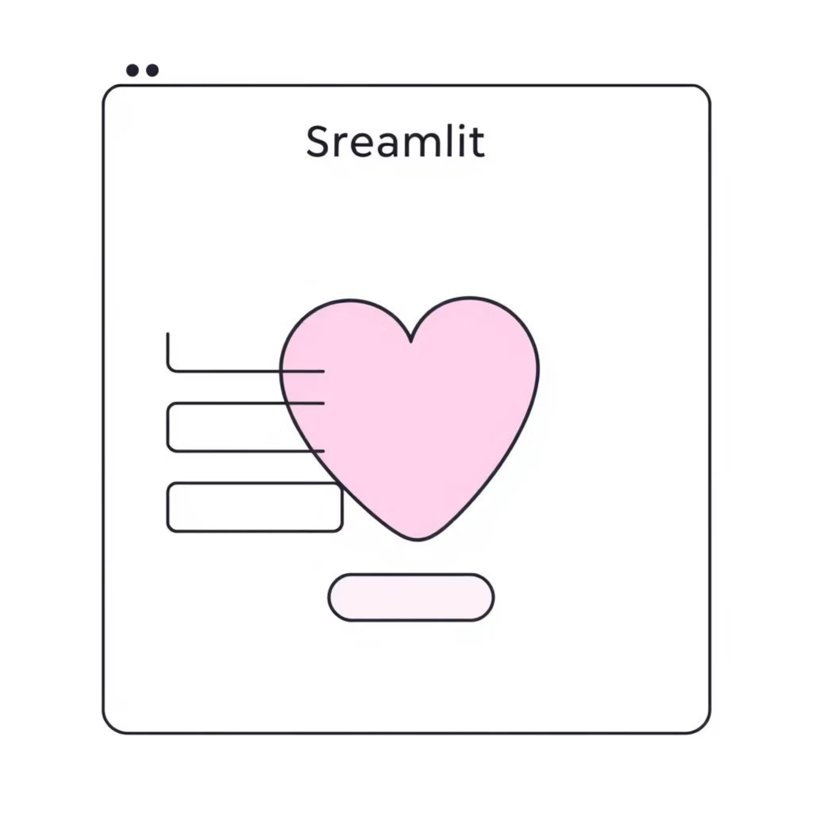
Transforming Research into Practice: The Streamlit Application
To make our predictive model accessible and intuitive for clinical use, we deployed it within a web application built using Streamlit.
Purpose-Built for Practicality
The application allows users (e.g., clinicians) to input patient features interactively and receive an instant, accurate prediction of heart disease risk.
Intuitive interface mirrors clinical data input.
Provides near real-time predictions.
Supports rapid hypothesis testing with different patient profiles.
This tool transforms the static ML model into a dynamic, practical diagnostic aid.

Slide 10
Conclusion and Future Directions
Project Success Summary
Future Work and Scaling
High Accuracy Achieved
Large-Scale Deployment
Developed a model with 90.16% accuracy on the test set.
Integrate the final model into hospital EHR systems or cloud infrastructure for production use.
Full Transparency
Data Augmentation
Model interpretability verified using SHAP, moving beyond the "black box."
Retrain the model on significantly larger and more diverse datasets to enhance generalization across patient populations.
Practical Deployment
Created a Streamlit application ready for immediate, interactive use.
Advanced Modeling
Explore deep learning architectures (e.g., LSTMs for time-series data) for predictive tasks.
Thank You. Questions?

